Slide 1
Java Spring Framework

Slide 2
What is Spring?
The Spring framework is a powerful and flexible framework focused on building Java applications.
Spring Framework is a Java platform that provides comprehensive infrastructure support for developing Java applications. Spring handles the infrastructure so you can focus on your application.

Slide 3
What Spring provides
The Spring Framework addresses the concern of organizing the basic building blocks into a coherent whole ,by providing a formalized means of composing disparate components into a fully working application ready for use.
The Spring Framework codifies formalized design patterns as first-class objects that you can integrate into your own application(s). Numerous organizations and institutions use the Spring Framework in this manner to engineer robust, maintainable applications.
Notes:
The Core Container consists of the Core, Beans, Context, and Expression Language modules.
The Core and Beans modules provide the fundamental parts of the framework, including the IoC and Dependency Injection features. TheBeanFactory is a sophisticated implementation of the factory pattern. It removes the need for programmatic singletons and allows you to decouple the configuration and specification of dependencies from your actual program logic.
The Context module builds on the solid base provided by the Core and Beans modules: it is a means to access objects in a framework-style manner that is similar to a JNDI registry. The Context module inherits its features from the Beans module and adds support for internationalization (using, for example, resource bundles), event-propagation, resource-loading, and the transparent creation of contexts by, for example, a servlet container. The Context module also supports Java EE features such as EJB, JMX ,and basic remoting. TheApplicationContext interface is the focal point of the Context module.
The Expression Language module provides a powerful expression language for querying and manipulating an object graph at runtime. It is an extension of the unified expression language (unified EL) as specified in the JSP 2.1 specification. The language supports setting and getting property values, property assignment, method invocation, accessing the context of arrays, collections and indexers, logical and arithmetic operators, named variables, and retrieval of objects by name from Spring's IoC container. It also supports list projection and selection as well as common list aggregations.

Slide 4
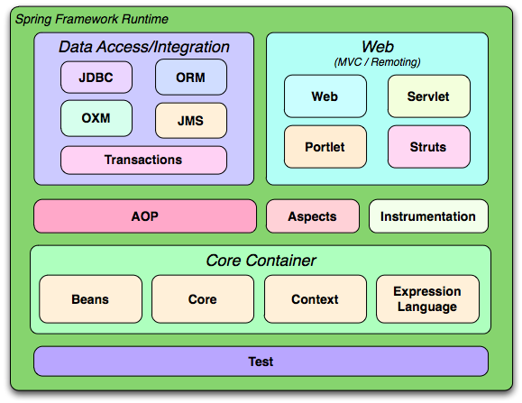
Spring Modules and Architecture
Notes:
Although the Java platform provides a wealth of application development functionality, it lacks the means to organize the basic building blocks into a coherent whole, leaving that task to architects and developers. True, you can use design patterns such as Factory, Abstract Factory, Builder, Decorator, and Service Locatorto compose the various classes and object instances that make up an application. However, these patterns are simply that: best practices given a name, with a description of what the pattern does, where to apply it, the problems it addresses, and so forth. Patterns are formalized best practices that you must implement yourself in your application.
https://docs.spring.io/spring/docs/3.0.x/spring-framework-reference/html/overview.html

Slide 5
Spring /IOC
IoC is also known as dependency injection (DI). It is a process whereby objects define their dependencies, that is, the other objects they work with, only through constructor arguments, arguments to a factory method, or properties that are set on the object instance after it is constructed or returned from a factory method.
The container then injects those dependencies when it creates the bean. This process is fundamentally the inverse, hence the name Inversion of Control (IoC), of the bean itself controlling the instantiation or location of its dependencies by using direct construction of classes, or a mechanism such as the Service Locator pattern.

Slide 6
Dependency Injection
Java components / classes should be as independent as possible of other Java classes. This increases the possibility to reuse these classes and to test them independently of other classes(Unit Testing). To decouple Java components from other Java components the dependency to a certain other class should get injected into them rather that the class itself creates / finds this object. A class A has a dependency to class B if class uses class B as a variable.
If dependency injection is used then the class B is given to class A via
the constructor of the class A - this is then called construction injection
a setter - this is then called setter injection
The general concept between dependency injection is called Inversion of Control. A class should not configure itself but should be configured from outside.

Slide 7
Client Code
Booking Service
Customer Bean
BookingDao Implementation

Slide 8
Spring Hello World
Steps
Create the Bean Class
Create a xml file to configure the Bean class
Write a Client

Slide 9
package com.myapp.core;
public class HelloWorld {
private String name;
public void setName(String name) {
this.name = name;
}
public void printHello() {
System.out.println("Spring 3 : Hello ! " + name);
}
}
HelloWorld.java
SpringBeans.xml
<beans xmlns="http://www.springframework.org/schema/beans"
xmlns:xsi="http://www.w3.org/2001/XMLSchema-instance"
xsi:schemaLocation="http://www.springframework.org/schema/beans
http://www.springframework.org/schema/beans/spring-beans-3.0.xsd">
<bean id="helloBean" class="com.myapp.core.HelloWorld">
<property name="name" value="Java" />
</bean>
</beans>

Slide 10
Test Client
public class App {
public static void main(String[] args) {
ApplicationContext context = new ClassPathXmlApplicationContext(
"SpringBeans.xml");
HelloWorld obj = (HelloWorld) context.getBean("helloBean");
obj.printHello();
}
}

Slide 11
DI Example
public interface OperationI {
public int operate(int x,int y);
}
public class AOperate implements OperationI {
@Override
public int operate(int x, int y) {
return x+y;
}}
public class MOperate implements OperationI {
@Override
public int operate(int x, int y) {
return x*y;
}
}

Slide 12
DI - Demo
public class OperationDemo {
private OperationI oInterface;
public void init()
{
System.out.println("Init...");
}
public OperationI getoInterface() {
return oInterface;
}
public void setoInterface(OperationI oInterface) {
this.oInterface = oInterface;
}
public int getOperation(int x,int y)
{
return oInterface.operate(x, y);
}
public void destroy()
{
System.out.println("Destroy...");
}
}

Slide 13
//Client Code
ApplicationContext context =
new ClassPathXmlApplicationContext("beans2.xml");
OperationDemo demo=(OperationDemo) context.getBean("operationDemo");
System.out.println(demo.getOperation(12, 5));
//beans2.xml
<bean id="operationId"
class="com.classes.MOperate">
</bean>
<bean id="operationDemo"
class="com.classes.OperationDemo">
<property name="oInterface" ref="operationId"></property>
</bean>

Slide 14
AutoWiring
There are different ways through which we can autowire a spring bean.
autowire byName – For this type of autowiring, setter method is used for dependency injection. Also the variable name should be same in the class where we will inject the dependency and in the spring bean configuration file.
autowire byType – For this type of autowiring, class type is used. So there should be only one bean configured for this type in the spring bean configuration file.
autowire by constructor – This is almost similar to autowire byType, the only difference is that constructor is used to inject the dependency.

Slide 15
Bean LifeCycle
<bean id="operationDemo"
class="com.classes.OperationDemo" autowire="byType" init-method="init" destroy-method="destroy">
<!-- <property name="oInterface" ref="operationId"></property> -->
</bean>
Before the business logic executes init-method is called as soon as the bean is loaded into memory.
Before the bean is deallocated destroy method is called.

Slide 16
Collection Injection
<property name="addressList">
<list>
<value>INDIA</value>
<value>Pakistan</value>
<value>USA</value>
<value>USA</value>
</list>
</property>
<property name="addressSet">
<set>
<value>INDIA</value>
<value>Pakistan</value>
<value>USA</value>
<value>USA</value>
</set>
</property>
<property name="addressMap">
<map>
<entry key="1" value="NDIA"/>
<entry key="2" value="Pakistan"/>
<entry key="3" value="USA"/>
<entry key="4" value="USA"/>
</map>
</property>
<property name="addressProp">
<props>
<prop key="one">INDIA</prop>
<prop key="two">Pakistan</prop>
<prop key="three">USA</prop>
<prop key="four">USA</prop>
</props>
</property>

